Slide 1
Transform data into intelligent action
David Gristwood

Slide 2






Transform data into intelligent action
Information Management
Data Stores
Machine Learning and Analytics
Intelligence
People
Data Sources
Data Factory
Data Lake Store
Machine Learning
Cognitive Services
Data Catalog
SQL Data
Warehouse
Data Lake Analytics
Bot Framework
Web
Apps
HDInsight
(Hadoop and Spark)
Mobile
IoT Hub
Cortana
Apps
Bots
Sensors and devices
App Services
Stream Analytics
Dashboards & Visualizations
DocumentDB
Automated Systems
Redis Cache
Power BI
Data
Intelligence
Action

Slide 3
Data at Scale
Information Management
Big Data Stores
Machine Learning and Analytics
Intelligence
Data Factory
Data Lake Store
manages
SQL Data
Warehouse
Data Lake Analytics
OR
Data Sources
HDInsight
(Hadoop and Spark)
Dashboards & Visualizations
Notes:
T: Cortana Intelligence provides everything you need to transform your organization’s data into intelligent action. Next, let’s take a look at another demo.

Slide 4
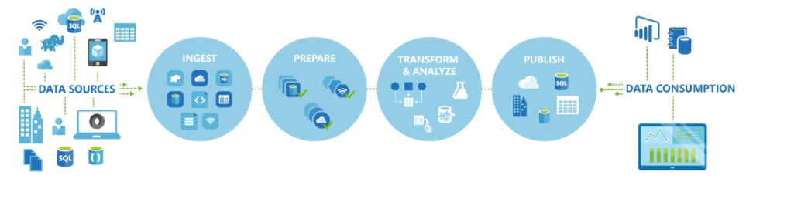
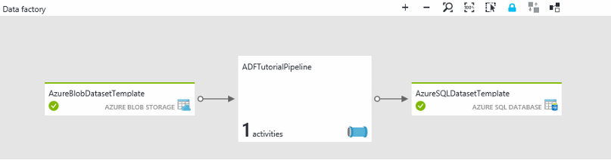
Azure Data Factory
A managed cloud service for building and operating data pipelines
Create, schedule, orchestrate, manage data pipelines
Visualise data lineage
Monitor data pipeline health
Connect to on-premises and cloud data sources
https://azure.microsoft.com/services/data-factory/

Slide 5
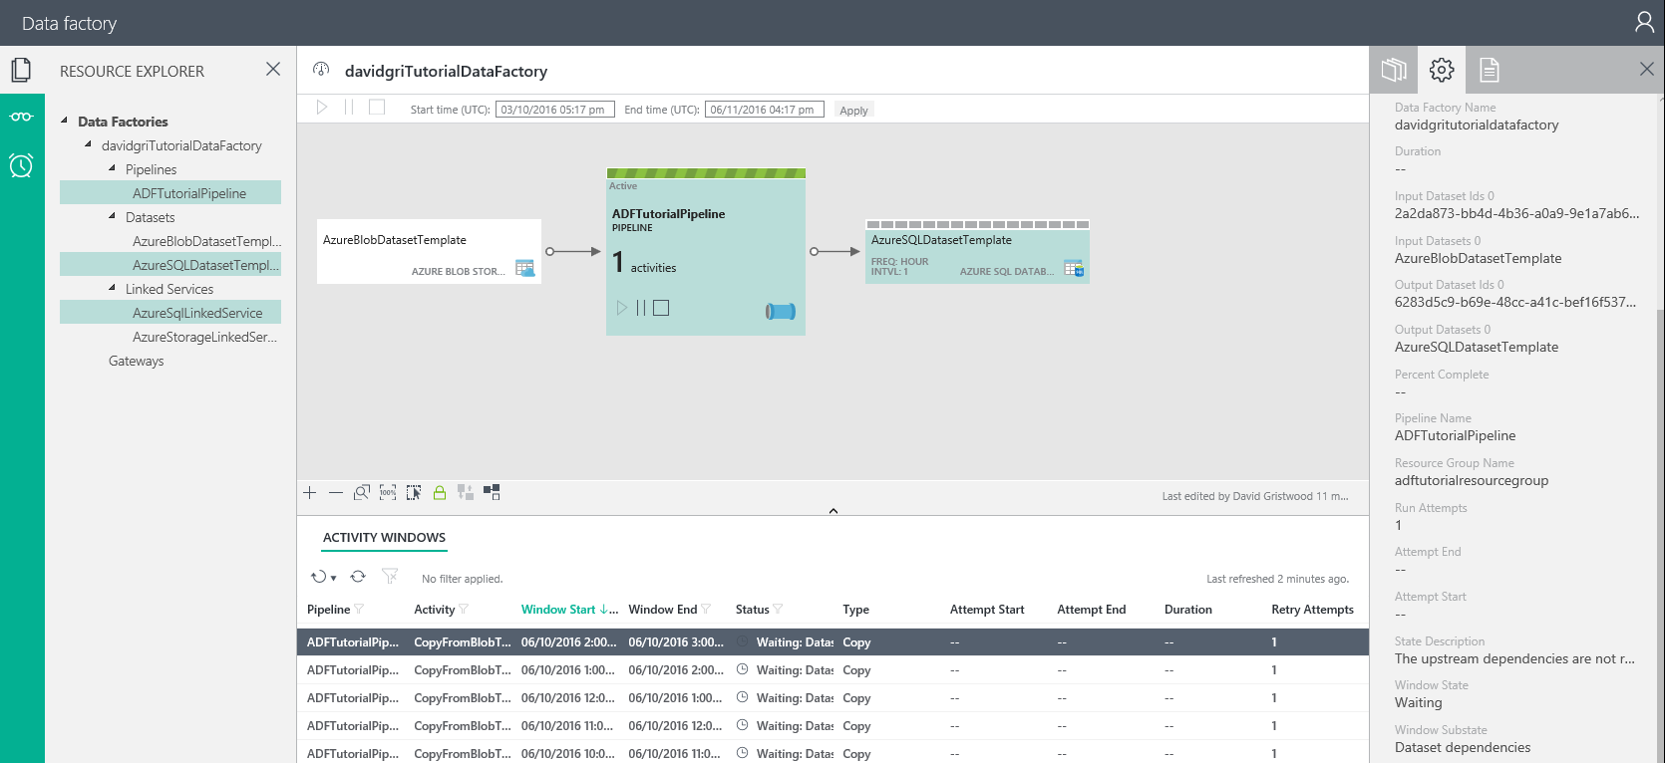
Data Factory Monitoring

Slide 6


Azure Data Lake
Analytics
HDInsight
(“managed clusters”)
Azure Data Lake Analytics
Storage
Azure Data Lake Storage

Slide 7




A highly scalable, distributed, parallel file system in the cloud Designed to work with multiple analytic frameworks
Azure Data Lake Store
Devices
Social
ADL Analytics
LOB Applications
Video
ADL Store
HDInsight
R
Web
Sensors
Spark
Relational
Clickstream
Machine Learning

Slide 8
Azure Data Lake Analytics Service
A new distributed analytics service
Built on Apache YARN
Scales dynamically with the turn of a dial
Pay by the query
Supports Azure AD for access control, roles, and integration with on-premise identity systems
Built with U-SQL to unify the benefits of SQL with the power of C#

Slide 9
Data at Speed
Information Management
Big Data Stores
Machine Learning and Analytics
Intelligence
Data Lake Store
Machine Learning
SQL Data
Warehouse
Apps
Apps
IoT Hub
People
Stream Analytics
Dashboards & Visualizations
Sensors and devices
Power BI
Automated Systems
Notes:
T: Cortana Intelligence provides everything you need to transform your organization’s data into intelligent action. Next, let’s take a look at another demo.

Slide 10
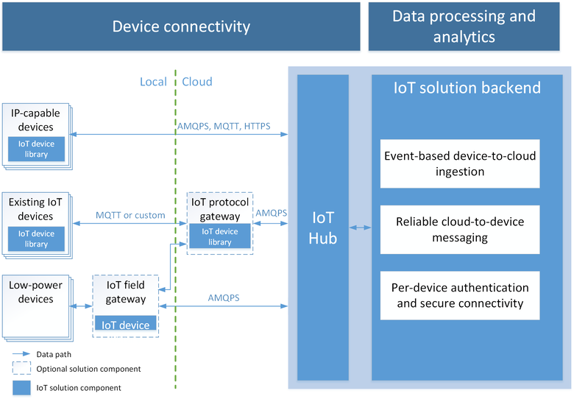
Azure IoT Hub
Telemetry ingestion
Millions of devices
Secure bi-directional communication
AMQP, HTTP, MQTT, custom protocols
Multiple platforms device SDKs

Slide 11
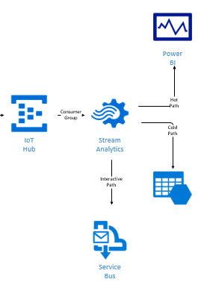
Azure Stream Analytics
Stream millions events per second
Perform time based work
Mission critical reliability
SQL-like language
Create real time alerts
Notes:
ASA can not only handle millions of events per second but it can also correlate across multiple independent streams of data simultaneously. This high speed event processing allows for the real time detection of anomalies or escalations based on threshold breaches or alarm settings as the data is ingested. The architecture is simple and easily scalable to an enterprise ready solution.
Azure Stream Analytics:
Real time analytics
Millions of events per second
Low latency, high througput

Slide 12


Azure Streaming Analytics
Data at Rest
Data in Motion
“Every 5 seconds give me the count of tweets over the last 10 seconds”
SELECT Topic, Count(*) AS TotalTweets
FROM TwitterStream
TIMESTAMP BY CreatedAt
GROUP BY Topic, HoppingWindow(second, 10, 5)

Slide 13
Data at Speed with Apache Storm/Spark
Information Management
Big Data Stores
Machine Learning and Analytics
Intelligence
Data Lake Store
R
R Server
Apps
Apps
HDInsight
Storm/Spark
Event Hubs
Cortana
Dashboards & Visualizations
Sensors and devices
Power BI
Automated Systems
Notes:
T: Cortana Intelligence provides everything you need to transform your organization’s data into intelligent action. Next, let’s take a look at another demo.

Slide 14
Traditional BI
Information Management
Big Data Stores
Machine Learning and Analytics
Intelligence
Data Factory
manages
People
SQL Data
Warehouse
Data Sources
Cortana
Dashboards & Visualizations
Power BI
Notes:
T: Cortana Intelligence provides everything you need to transform your organization’s data into intelligent action. Next, let’s take a look at another demo.

Slide 15
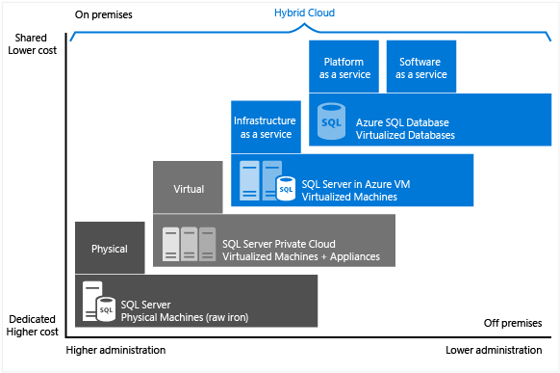
SQL Database (aka ‘SQL Azure’)

Slide 16
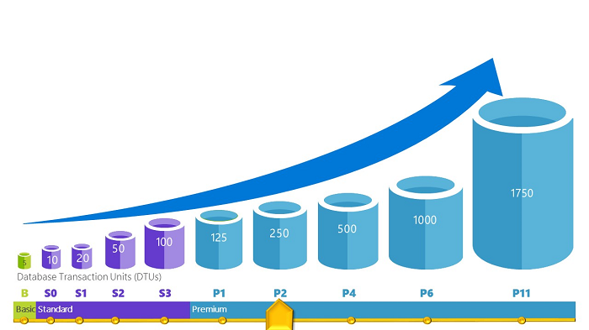
SQL Database
Database Transaction Unit (DTU) is unit of measure represents relative power databases
Provides increasing set of resources (‘power’) to offer increasingly higher throughput
Rating measured using the Azure SQL Database Benchmark

Slide 17



Elastic Scale
Spin up for heavy workloads, cycle down for daily activity
Buy time to insight based on what you need, when you need it
Choose the combo of compute and storage that meets your needs
Elastic scale & performance
Market Leading Price & Performance
Powered by the Cloud

Slide 18
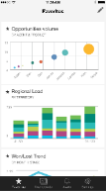
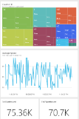
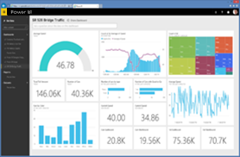
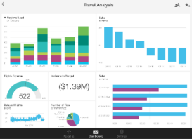
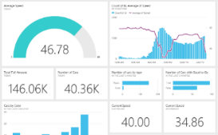
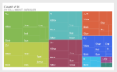
Microsoft Power BI
Data sources
Power BI
SaaS solutions
e.g. Marketo, Salesforce, GitHub, Google analytics
Content packs
Natural language query
Sharing & collaboration
On-premises data
e.g. Analysis Services
Live dashboards
Organizational content packs Corporate data sources or external data services
Visualizations
Azure services
Azure SQL, Stream Analytics…
Reports
Excel files
Workbook data / data models
01001
10101
Power BI Desktop files
Data from files, databases, Azure, and other sources
Datasets
Data refresh
Create beautiful visualizations to tell compelling data stories Build rich, live dashboards that turn business intelligence into real insights
Notes:
1. The Power BI service, sometimes referred to as powerbi.com, is what allows you to:
Create beautiful visualizations to tell compelling data stories
Build rich, live dashboards that turn BI into business insights
Create reports & datasets from which you can create visualizations and dashboards
Enjoy the benefits of up-to-date data with real-time, automatic and scheduled refreshes
Share dashboards easily with other people in your organization
Ask questions of data in plain English with Natural Language Query
Stay connected to your data all the time with mobile applications
2. Power BI connects to a variety of data sources. These range across both cloud and on-premises sources, and include:
A variety of popular SaaS solutions, such as Marketo, Salesforce, GitHub, Dynamics CRM, Zendesk, and several others
On-premises databases – Power BI offers live connectivity to SQL Server Analysis Services, which we’ll cover in more detail later. And using a gateway solution, Power BI can connect to other database solutions.
Custom data sources – Power BI can connect to any data source you need it to thanks to its extensibility via REST APIs. This includes both proprietary corporate data sources, as well as external data services. For example, if you are a SaaS solution provider, you can work with Microsoft to connect your solution to Power BI.
Other Azure services – Power BI integrates tightly with SQL Azure and Stream Analytics, and will be integrating closely with more Azure services over time
Power BI Desktop and Excel files – Excel workbooks can be directly connected to Power BI.com, or may be used with Power BI Desktop. Power BI Desktop is a companion application to the Power BI service – it is a desktop tool that supports data analysis and reporting. Like Excel files, Power BI Desktop files may be uploaded to the Power BI service.

Slide 19
Business Applications
Information Management
Big Data Stores
Machine Learning and Analytics
Intelligence
SQL Database
Apps
Apps
App Services
DocumentDB
People
Dashboards & Visualizations
Redis Cache
Embedded Power BI
Notes:
T: Cortana Intelligence provides everything you need to transform your organization’s data into intelligent action. Next, let’s take a look at another demo.

Slide 20
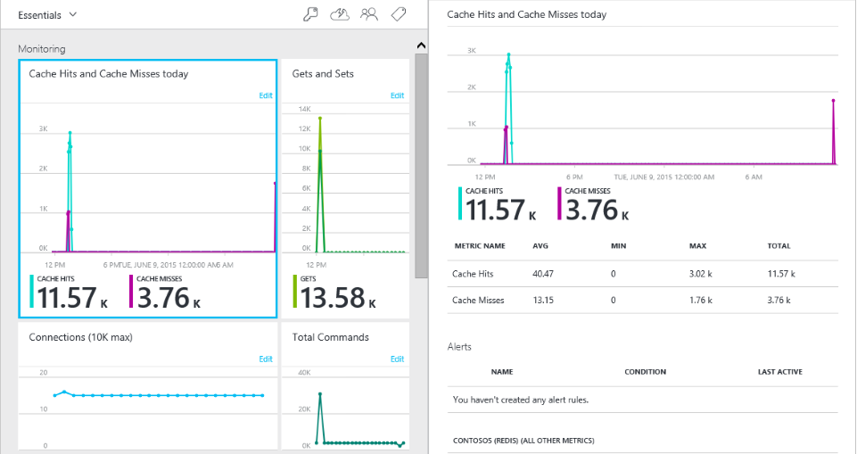
Redis Cache
Dedicated, managed Redis cache
Advanced key-value store
High-availability offering

Slide 21
Azure DocumentDB
NoSQL as a service
Highly available, globally distributed
Benefits of SQL and JavaScript, schema-free
Guaranteed low latency write-optimised, latch-free database engine
Protocol support for MongoDB

Slide 22

Azure Search
Fully managed service search service
Based on ElasticSearch engine
Avoid hassle of index corruption, service availability, scaling and service updates
Load and update with integrated indexers
Control over search rankings with facets, weightings
Integration with Microsoft’s Natural Language Processors

